Slide 1
In partnership with
The Mindful Leader™
The Inner Work That Will Rock Your Outer World

Slide 2
Session Overview and Resources
Presentation run through
Individual slide review
Q&A
We have created a resource page for your reference that can be found here
The IMF home page and resources can be found here
http://www.executivecoachinguniversity.com/landing/cu_leeds/
http://www.mindfulnessfederation.org/

Slide 3
Who are you grateful for?
Notes:
At start of class ask: How many people have meditated before?

Slide 4
Gratitude Meditation
Notes:
Have students close their eyes and take three deep breaths. After the third breath have them visualize someone in their life that they are extremely grateful for. Have them picture this person in great detail. Visualize how this person makes them feel when they are around them. Encourage them to continue breathing, have them count “one” on the in breath and “two” on the out breath. After three minutes, ask them to shift their awareness to the present and open their eyes when it feels right.

Slide 5
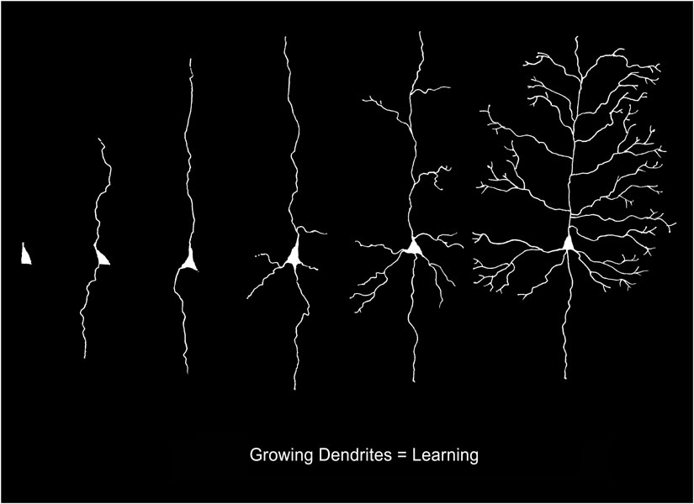
Axons and Dendrites
Notes:
Share with the students that this is what happens to their brains when they meditate. The slender trunks are the axons and the branches are the dendrites. Each of these grow and build new positive pathways in the brain every time they meditate. Their brains literally grow, creating new gray matter.

Slide 6
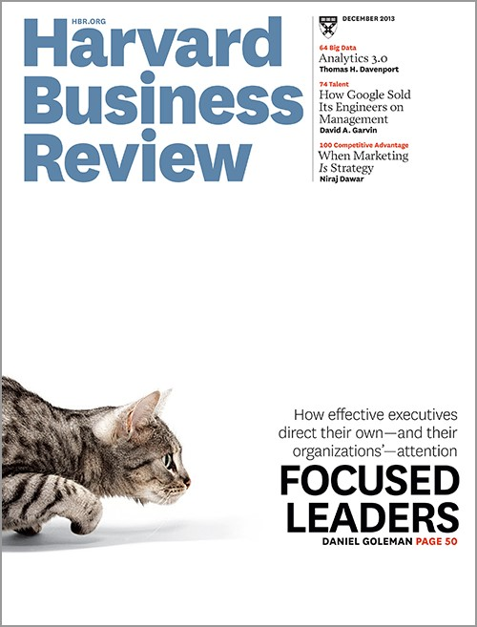
Mindfulness is a “Must Have”
Mindfulness should no longer be considered a ‘nice to have’ for executives. It’s a ‘must have.’
~Harvard Business Review
Notes:
Share with the students that this is what happens to their brains when they meditate. The slender trunks are the axons and the branches are the dendrites. Each of these grow and build new positive pathways in the brain every time they meditate. Their brains literally grow, creating new gray matter.

Slide 7
Harvard Mindfulness Research
Extensive hard neuroscience
Superior performance on tests of self-regulation, decision-making, focus, and creativity
Can literally change your brain

Slide 8
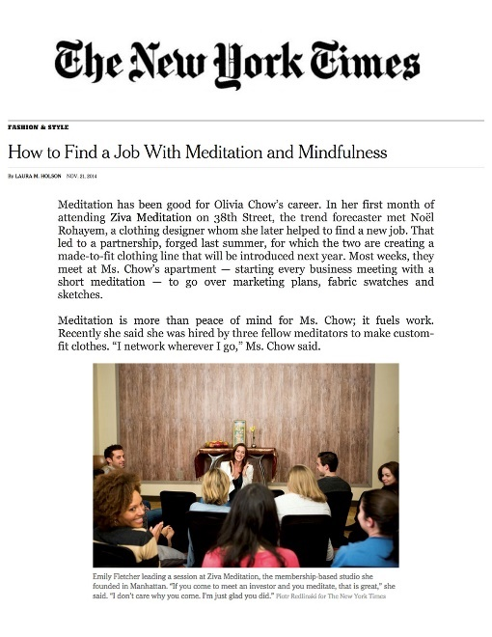
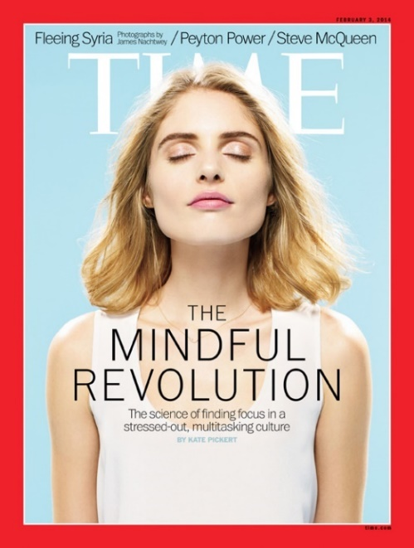
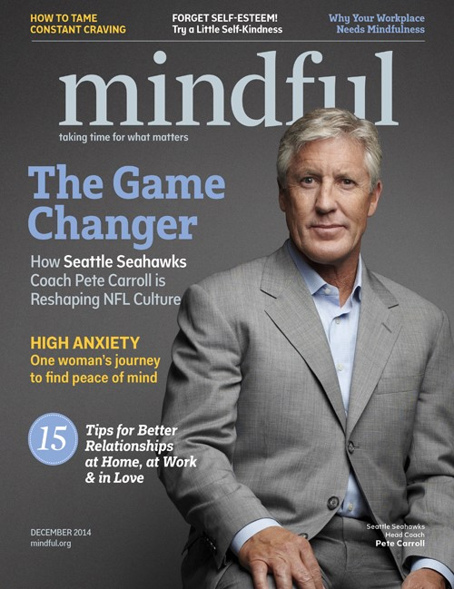
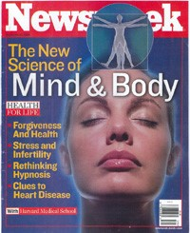
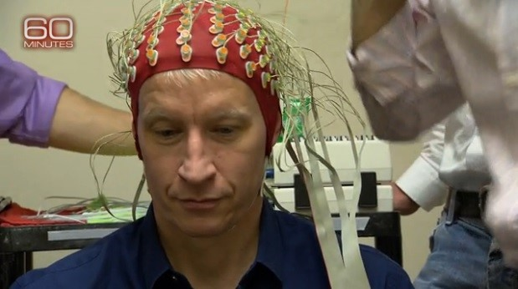
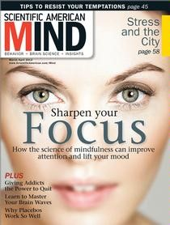
Notes:
Mindfulness and meditation are all over the news.

Slide 9
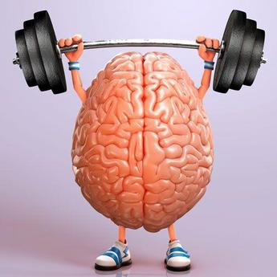
Mindfulness = Mental Training
Notes:
Share with the students that working on mindfulness is really working out their brains. As they exercise to keep their bodies healthy, so should they work out their brains.

Slide 10
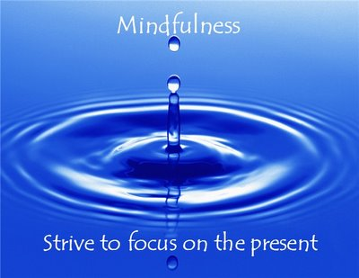
Mindfulness Is…
Notes:
Have the students hold their left arm up and horizontal across the front of their body. Have then hold their right arm vertical while resting on their left arm. Have them close their eyes. Have them think of their right arm as a windshield wiper. Now, have them envision how busy their mind is on Sunday nights as they think of all they have to do in the coming week. Have them move their right arm to the speed that their mind is operating at (usually very fast). Now, have them focus on their breath and request that they focus on reducing the speed of their mind by 50%. After a minute, ask that they reduce the speed again by another 50%. To conclude, have them lower both arms and focus on their breath for another 2 minutes. The goal is to have them realize that they can slow their thoughts down with awareness and focus.

Slide 11
Windshield Wiper Exercise
Notes:
Have the students hold their left arm up and horizontal across the front of their body. Have then hold their right arm vertical while resting on their left arm. Have them close their eyes. Have them think of their right arm as a windshield wiper. Now, have them envision how busy their mind is on Sunday nights as they think of all they have to do in the coming week. Have them move their right arm to the speed that their mind is operating at (usually very fast). Now, have them focus on their breath and request that they focus on reducing the speed of their mind by 50%. After a minute, ask that they reduce the speed again by another 50%. To conclude, have them lower both arms and focus on their breath for another 2 minutes. The goal is to have them realize that they can slow their thoughts down with awareness and focus.

Slide 12
I.M.F.
Bringing mindfulness into the mainstream™
Notes:
The International Mindfulness Federation is the new international association for mindfulness. It is based in Colorado. Their web site has a vast amount of resources on mindfulness and meditation including over 2,600 articles and over 100 videos. http://www.mindfulnessfederation.org/

Slide 13
Guiding Principles
Seeks to serve in every
Mindful Moment
Listens and responds with heart and head
Demonstrates compassion for self and others
Observes thoughts and deeds without judgment
Lives in a state of gratitude
Notes:
The IMF has created five Guiding Principles that describe what a Mindful Leader “looks” like. The exercises that we are doing today reflect two of these five: Gratitude and Compassion.

Slide 14
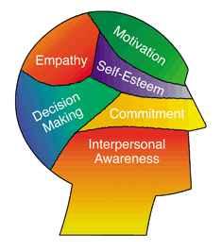
Mindfulness & Emotional Intelligence
Notes:
Mindfulness builds the emotional intelligence of people who practice it. You will be better able to lead with greater personal awareness and empathy.

Slide 15
What Mindfulness Isn’t
Religious/Woo-Woo
Time consuming
Hard

Slide 16
Companies and Meditation
McKinsey and Co.
Deutsche Bank
Proctor and Gamble
Nike
Apple
General Mills

Slide 17
Meditation= Better Leaders
Improved self management and energy
Greater productivity, creativity, and focus
Higher level of self awareness
…Happiness!
* Forbes Magazine

Slide 18
Meditation = Money
Increased productivity, clarity, focus
Improved employee engagement
Reduced healthcare and insurance costs
“We reduced our healthcare costs by 7% using meditation and yoga.”
~Aetna CEO – Marc Bertolini

Slide 19
Mindfulness and Stress
Stress costs U.S. businesses $326 Billion a year
85% of all illness is stress related
40% of people have an addiction issue
* New England Journal of Medicine, Gallop

Slide 20
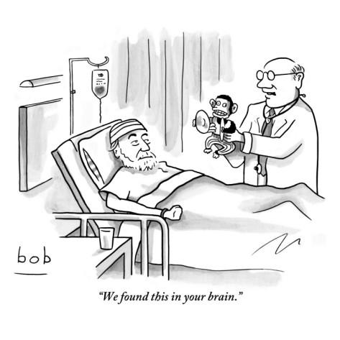
The Monkey Mind
We have 60,000 thoughts a day
95% of them were the same ones we had yesterday
71% of them are negative
*Chopra Institute
Notes:
Meditation will help quiet, and redirect in a positive (and healthier) direction, your thoughts.

Slide 21
Compassion Meditation
Notes:
Have the students envision a long road that they can see very far down. At the end of this road is something moving toward them. They keep watching it. As it gets closer they can make out a person’s features. It is someone whom they love very much and who loves them unconditionally. As the person gets closer they can see the beautiful, warm smile on the person’s face. They feel the love radiating from the person. As they get closer, the person holds out their arms and embraces them is a powerful love centered hug. As they hug they can feel the love pouring out of the other person. After a few moments, the person pulls back and tells them how much they love them. May you be: Healthy. May you be Safe. May you be Peaceful. May you be Happy. As the person starts to back away, they send them thoughts of loving kindness. As they proceed down the road away from the person, the person is left with a beautiful feeling of health, safety, peacefulness, and happiness. Now, have them embrace this feeling as what they wish for themselves. I am healthy. I am safe. I am peaceful. I am happy. Have them breath into this feeling for three minutes.

